Slide 1
Community accomplishment data 2019

Slide 2
Community health improvement plan
Poverty and jobs
Behavioral health
Safe and affordable housing
Access to healthy food and physical activity
Equity & Discrimination
Notes:
def. - long-term, systematic effort to address public health problems on the basis of the results of community health assessment activities and the community health improvement process. This plan is used by health and other governmental education and human service agencies, in collaboration with community partners, to set priorities and coordinate and target resources. A community health improvement plan is critical for developing policies and defining actions to target efforts that promote health. It should define the vision for the health of the community through a collaborative process and should address the gamut of strengths, weaknesses, challenges, and opportunities that exist in the community to improve the health status of that community.

Slide 3
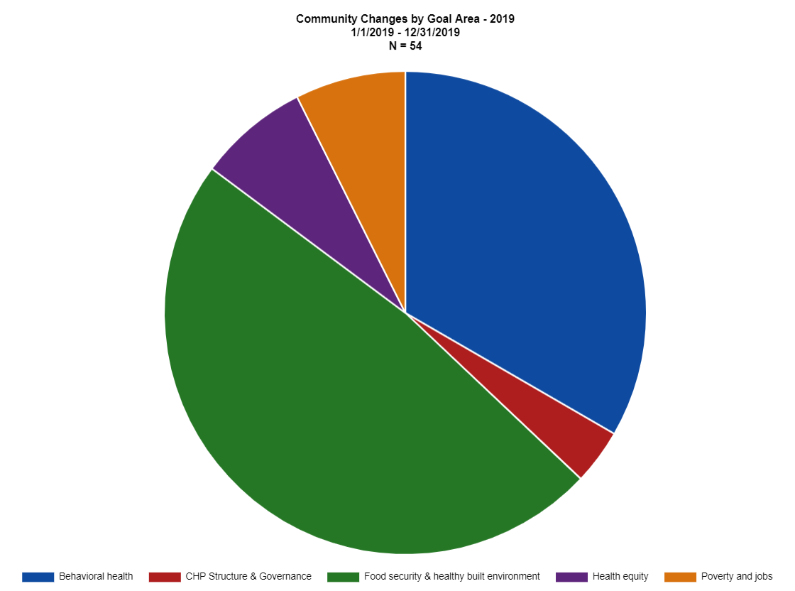

Slide 4
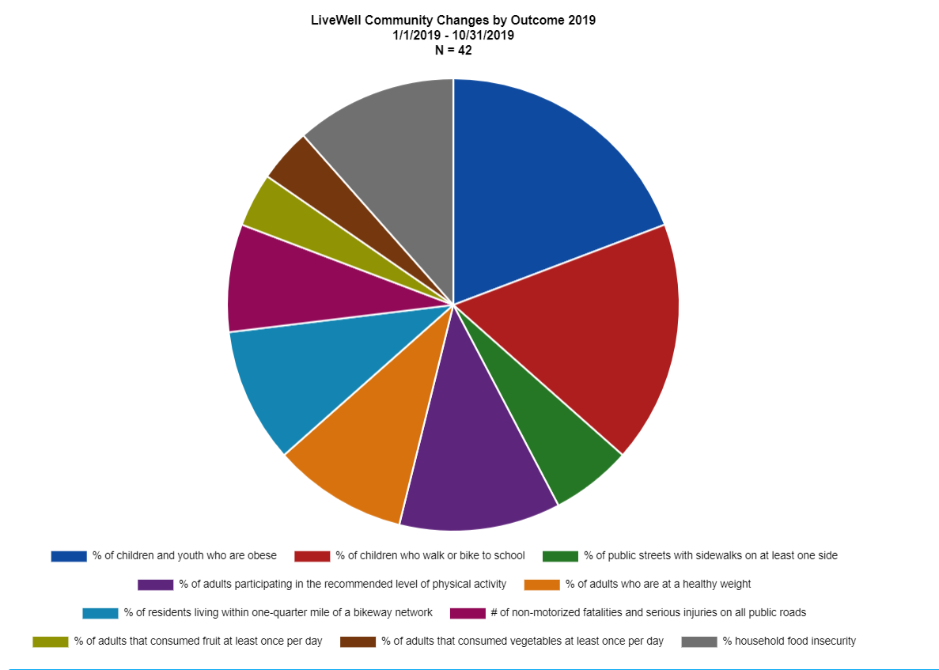

Slide 5
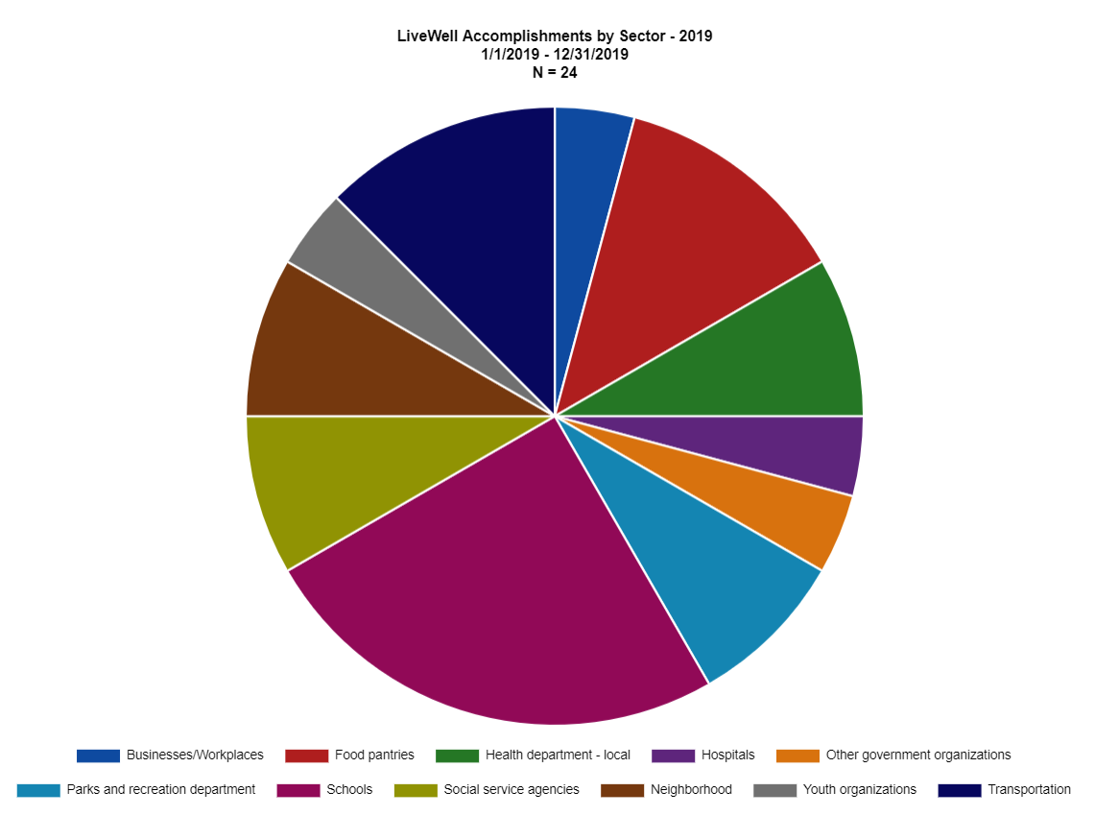
LiveWell Vision and Mission
Our Vision: Communities where we all thrive.
Our Mission: Leading a movement to build communities that support the health and well-being of all.

